Slide 1
ANOVA
Concept

Slide 2
From simple t-tests to ANOVA
We’ve seen that with simple t-tests we can
  Compare a single sample mean with a population mean
  Compare two different sample means
But real world analysis is not always that straightforward
Even where we have a single independent variable, a study may require participants to be exposed to more than one level of that variable
Why not use a series of t-tests?

Slide 3
ANOVA
With multiple combinations of t tests, it becomes more likely that you will observe a ‘significant’ difference because of chance alone.
Experiment-wise error: The more statistical tests run, the greater likelihood that the researcher will obtain seemingly significant effects due to chance alone
The analytic approach used to resolve this difficulty is called analysis of variance or ANOVA
  – the ANOVA determines whether the amount of variance between the groups is greater than the variance within the groups
ANOVAs also allow us to consider the effects of more than one independent variable and whether they interact

Slide 4
How the potential experiment-wise error is avoided
In a One-Way ANOVA we run an overall ‘F’ test –this is in effect an omnibus test
It tells us if there any of the means that are different from one another
Because its an omnibus test
  It avoids the accumulation of Type 1 error
  It will tell us if there is an effect ‘somewhere’
  But at least one follow-up test is required

Slide 5
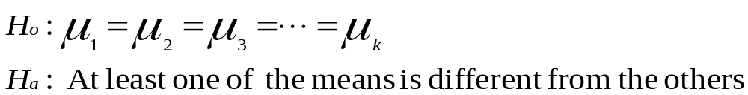
One-Way ANOVA:
Procedural Overview
The null hypothesis states that the population means for all treatment levels are equal
Even if one of the population means is different from the other, the null hypothesis is rejected
Testing the hypothesis is done by portioning the total variance of data into the following two variances
  Variance resulting from the treatment (between)
  Error variance (within) or that portion of the total variance unexplained by the treatment
Notes:
9

Slide 6
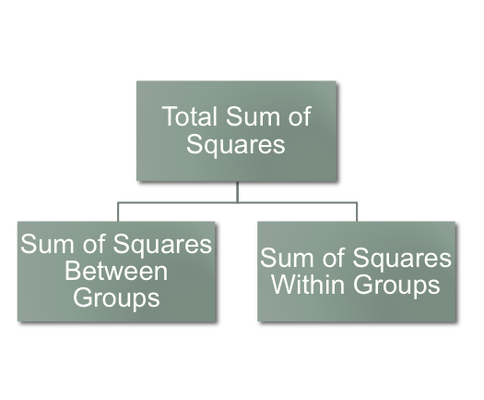
Analysis of Variance
The total sum of square of variation is portioned into the sum of squares (between) and the sum of squares (within)
ANOVA is used to determine statistically whether the variance between the treatment level means is greater than the variances within levels (error variance)
ANOVA compares the relative sizes of the treatment variation and the error variation - If a significant difference in treatment is present, the treatment variation should be large relative to the error variation
Notes:
8

Slide 7
One-Way ANOVA:
Example
Consider that a company wants to compare the productivity, as measured by the number of units produced per hour, among three production plants.
Randomly selected sample produced the following measurements:
Is there a difference in the number of items produced by each plant? Use α=.05.
Plant A | Plant B | Plant C
135 | 147 | 149
110 | 103 | 147
133 | 118 | 130
125 | 130 | 129
149 | 106
 | 128
Notes:
13

Slide 8
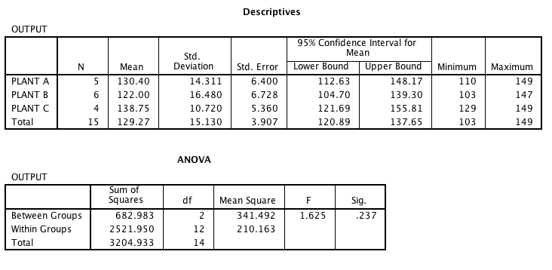
ANOVA Table
F value – determined by dividing the treatment variance (MSBetween) by the error variance (MSWithin)
F value is a ratio of the Between variance to the Within variance
Notes:
17

Slide 9
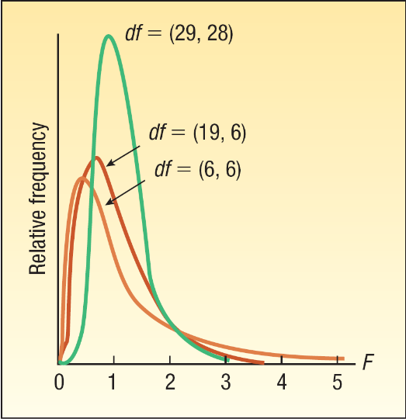
F distribution table
Associated with every F table are two unique df variables:
  degrees of freedom in the numerator and,
  degrees of freedom in the denominator
Statistics computer software packages for computing ANOVA usually give a probability for the F value, which allows hypothesis testing decisions for any alpha based on the p-value method

Slide 10
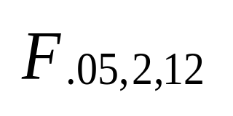
F Table for α = 0.05
df₁
 | 1 | 2 | 3 | 4 | 5 | 6 | 7 | 8 | 9
1 | 161.45 | 199.50 | 215.71 | 224.58 | 230.16 | 233.99 | 236.77 | 238.88 | 240.54
… | … | … | … | … | … | … | … | … | …
12 | 4.75 | 3.89 | 3.49 | 3.26 | 3.11 | 3.00 | 2.91 | 2.85 | 2.80
13 | 4.066 | 3.81 | 3.41 | 3.18 | 3.03 | 2.92 | 2.83 | 2.77 | 2.71
14 | 4.60 | 3.74 | 3.34 | 3.11 | 2.96 | 2.85 | 2.76 | 2.70 | 2.65
15 | 4.54 | 3.68 | 3.29 | 3.06 | 2.90 | 2.79 | 2.71 | 2.64 | 2.59
df ₂
df₂

Slide 11
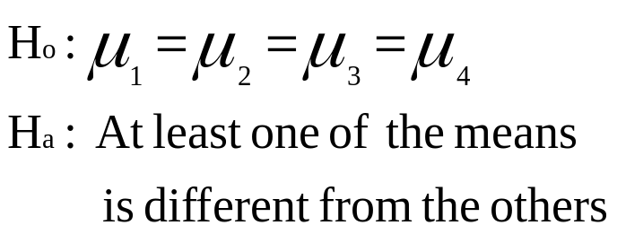
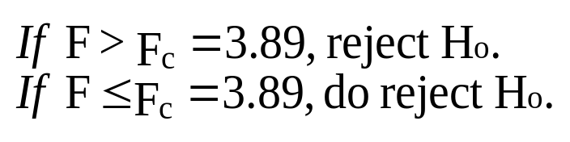
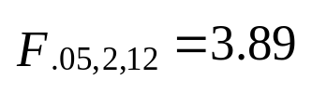
Summary
Rejection Region
Non rejection
Region
α = .05
Critical Value
Notes:
19

Slide 12
ANOVA Assumptions
Dependent variable is measured at interval or ratio level using a continuous scale
Normal Distribution
It is assumed that the populations from which the samples are taken are normally distributed
Homogeneity of Variance
Samples are obtained from populations of equal variance
SPSS performs Levene’s test (you are hoping to find that test is not significant, p > 0.05
Independence of Observations
Random Sampling

Slide 13
ANOVA Assumptions
Normal Distribution
It is assumed that the populations from which the samples are taken are normally distributed - Use SPSS histograms / box plots / Q – Q plots
When group sizes are equal the F-statistic can be quite robust to violations of normality. However, when group sizes are not equal the accuracy of F is affected.
We can also use the non-parametric Kruskal–Wallis test which does not assume normality.

Slide 14
ANOVA Assumptions
Homogeneity of Variance
There is an assumption that samples are obtained from populations of equal variance - This assumption can be tested using Levene’s test, which tests the null hypothesis that the variances of the groups are the same (you are hoping to find that test is not significant, p > 0.05)
In terms of violations of the assumption of homogeneity of variance, ANOVA is fairly robust in terms of the error rate when sample sizes are equal.
If Levene’s test is significant (i.e., the p-value is less than .05) we can adjust the F-test to correct the problem (just as we could with the t-test).
SPSS offers us two corrected versions of the F-ratio: the Brown–Forsythe F and Welch’s F

Slide 15
ANOVA Assumptions
Independence of Observations
Violations of the assumption of independence are serious.
- the Type I error rate is substantially inflated.

Slide 16
ANOVA
There are several types of ANOVA procedures:
  One-Way ANOVA
    Between Groups – looks at the amount of variance accounted for by the effect of the independent variable with the estimate of error removed. The further away from one the F value is, the lower the probability that the differences between the groups arose by chance.
    Repeated measures – participants complete the same set of tasks under different conditions or the same set of tasks are completed on more than one occasion
  Factorial ANOVA – more than one categorical independent variable
    The terms Two-way, Three-way etc. refer to how many independent variables there are in the analysis
  MANOVA (multivariate) –two or more related continuous dependent variables – not covered in this module

Slide 17
Post Hoc Tests
Post hoc tests consist of pairwise comparisons that are designed to compare all different combinations of the treatment groups - it is like taking every pair of groups and performing a t-test on each pair.
However, pairwise comparisons control the familywise error by correcting the level of significance for each test such that the overall Type I error rate across all comparisons remains at .05.
SPSS has 18 types of Post hoc Test
The Type I error rate and the statistical power of a test are linked. Therefore, there is always a trade-off: if a test is conservative (the probability of a Type I error is small) then it is likely to lack statistical power (the probability of a Type II error will be high).

Slide 18
Choice of Post-Hoc TEST
The least significant difference (LSD) pairwise comparison makes no attempt to control the Type I error and is equivalent to performing multiple t-tests on the data.
Tukey’s honestly significant difference test,, is somewhat limited by the fact that it requires equal sample sizes. Tukey’s HSD test takes into consideration the number of treatment levels, the value of mean square error, and the sample size and determines the critical difference necessary between the means of any two treatment levels for the means to be significantly different.

Slide 19

Choice of Post-Hoc TEST
Bonferroni’s and Tukey’s tests both control the Type I error rate very well but are conservative tests (they lack statistical power).
The REGWQ procedure has good power and tight control of the Type I error rate. In fact, when you want to test all pairs of means this procedure is probably the best. However, when group sizes are different this procedure should not be used.

Slide 20
Post Hoc Tests Recommendations:
Guidelines for choosing tests:
  Assumptions met (equal sample sizes, variances):
    REGWQ or Tukey HSD.
  Safe Option:
    Bonferroni.
  Unequal Sample Sizes:
    Gabriel’s (small n), Hochberg’s GT2 (large n).
  Unequal Variances:
    Games-Howell.
Slide <number>

Slide 21
Example:
One-way between groups (with post-hoc tests)
Refer to ‘Total Optimism’ example
Survey5ED.sav file
We have one categorical independent variable (with three or more levels of the factor
  In this example three age categories18-25, 26-49, 50+)
We have one continuous dependent variable
Research question: Is there a difference in optimism scores for young, middle aged & old participants
Because the omnibus test indicates a significant difference in the overall ANOVA we conduct post-hoc tests (Tukey HSD)

Slide 22
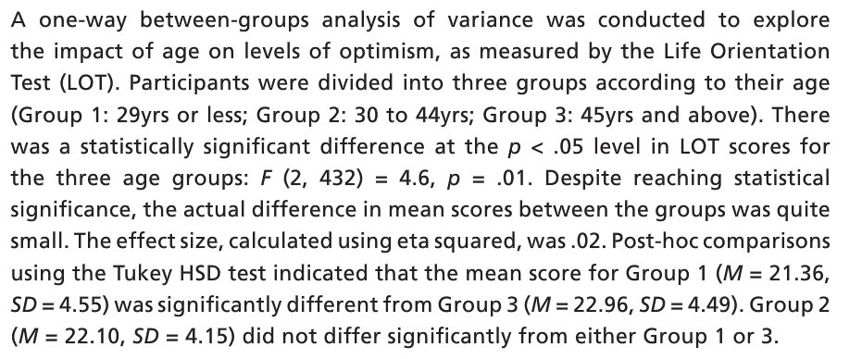
Example:
Presenting Results

Slide 23
ANOVA
Concept

